Slide 1
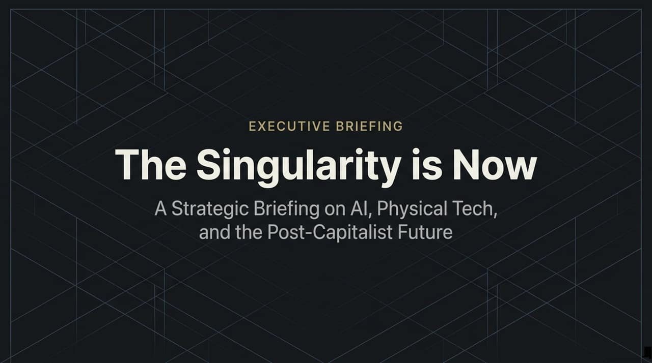
Notes:
https://www.youtube.com/watch?v=O70Ff5xBnYo
Good morning/afternoon, everyone. Today, we are taking a deep dive into the accelerating convergence of artificial intelligence, physical technology, and macroeconomics—what we call The Singularity."
"As discussed in recent industry briefings and podcasts, we are no longer talking about a distant future 10 or 20 years away. The structural shifts are unfolding right now in 2026."
"Over the next few minutes, we will break down how geopolitical tensions, open-weight models, BCI breakthroughs, and hyper-deflationary economics are reshaping the global market landscape. Let’s explore the three core frontiers driving this supersonic tsunami.

Slide 2
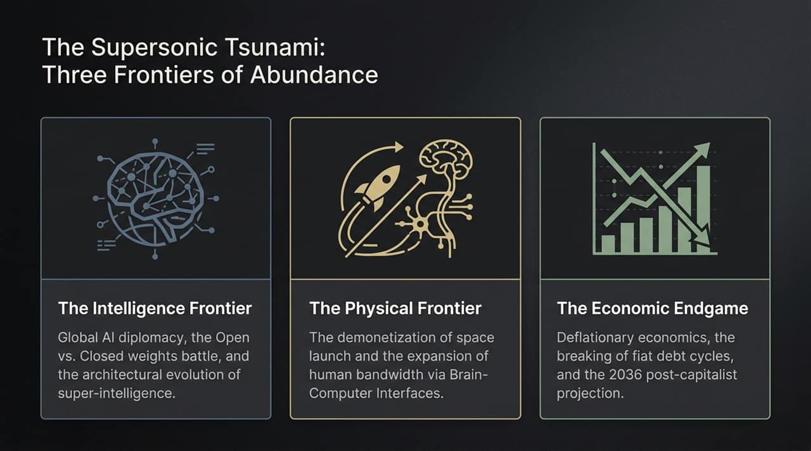
Notes:
To understand where value is migrating, we need to view the world through three distinct yet interconnected frontiers:"
"1. The Intelligence Frontier: This is the high-stakes battle between open and closed weights, the emerging global AI diplomacy between the US and China, and architectural shifts beyond the standard Transformer."
"2. The Physical Frontier: How software logic manifests in the real world. We are seeing space launch costs demonetize by orders of magnitude alongside rapid advances in Brain-Computer Interfaces (BCIs)."
"3. The Economic Endgame: The macro-level impact where hyper-deflationary technology collides with debt-heavy fiat systems, pointing towards a post-capitalist paradigm shift by the mid-2030s.

Slide 3
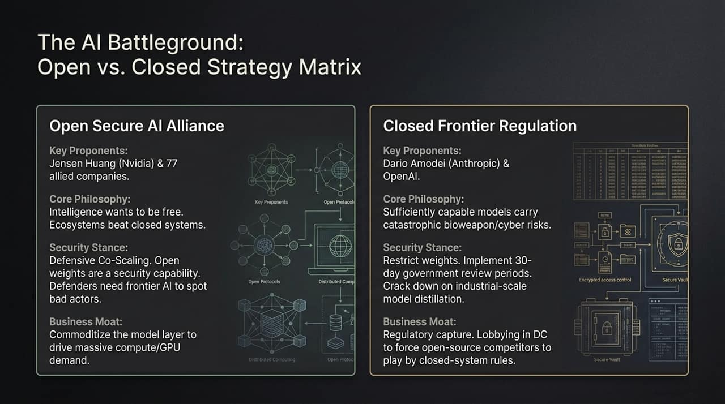
Notes:
A major ideological and commercial divide has emerged between two camps in the AI landscape:"
"On the left, we have the Open Secure AI Alliance, championed by Jensen Huang (Nvidia) and over 70 partner companies. Their core argument is that 'intelligence wants to be free' and open-weights act as a defensive capability. Jensen’s strategy is clear: commoditize the model layer to drive massive demand for compute and GPUs."
"On the right, we see the Closed Frontier Regulation camp, backed by labs like Anthropic and OpenAI. Citing catastrophic bioweapon and cyber risks, they advocate for 30-day government review periods and restrictions on open weights."
"Critics point out that this closed approach risks regulatory capture—using Washington lobbying to lock out open-weight competitors.

Slide 4
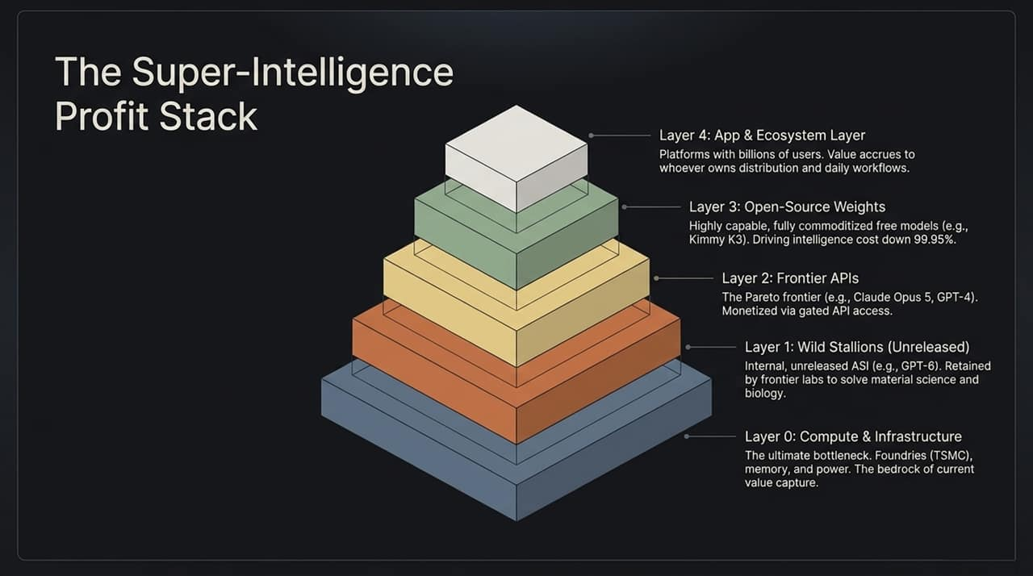
Notes:
Where does value sit across the AI stack? Let’s examine this 5-tier pyramid:"
"Layer 0 (Compute & Infrastructure): TSMC, energy, memory, and specialized hardware. This is the ultimate bottleneck and currently captures the highest margins."
"Layer 1 (Wild Stallions): Unreleased, internal frontier models (e.g., GPT-6 level) used directly by labs for material science and biology breakthroughs."
"Layer 2 & 3 (Frontier APIs & Open-Source Weights): Commercial APIs (Claude Opus 5) and free open weights (Kimmy K3). Open weights are aggressively driving down intelligence costs by over 99.9%."
"Layer 4 (App & Ecosystem Layer): Platforms that own daily consumer/enterprise workflows and distribution channels.

Slide 5
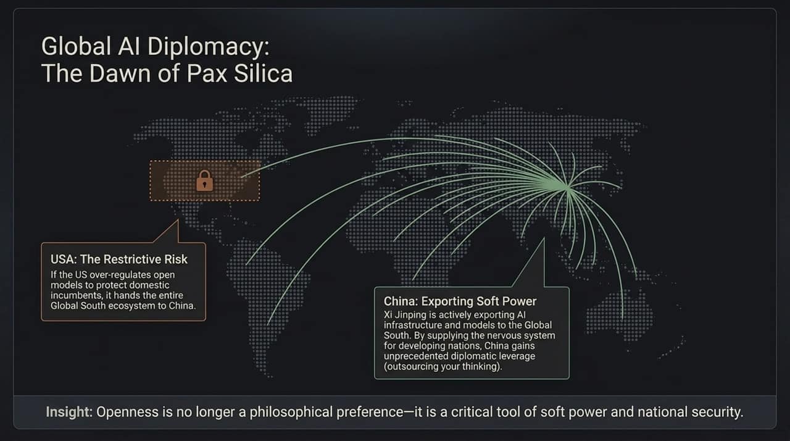
Notes:
AI has moved beyond commercial competition to become the core pillar of national security and soft power."
"If the United States over-regulates open-source models to protect domestic incumbents, it risks driving the Global South straight into China’s ecosystem."
"Under its 'Pax Silica' approach, China is actively exporting AI infrastructure and open models to developing nations, supplying their digital nervous system."
"Key Takeaway: Openness is no longer just a philosophy—it is an essential instrument of geopolitical soft power.

Slide 6
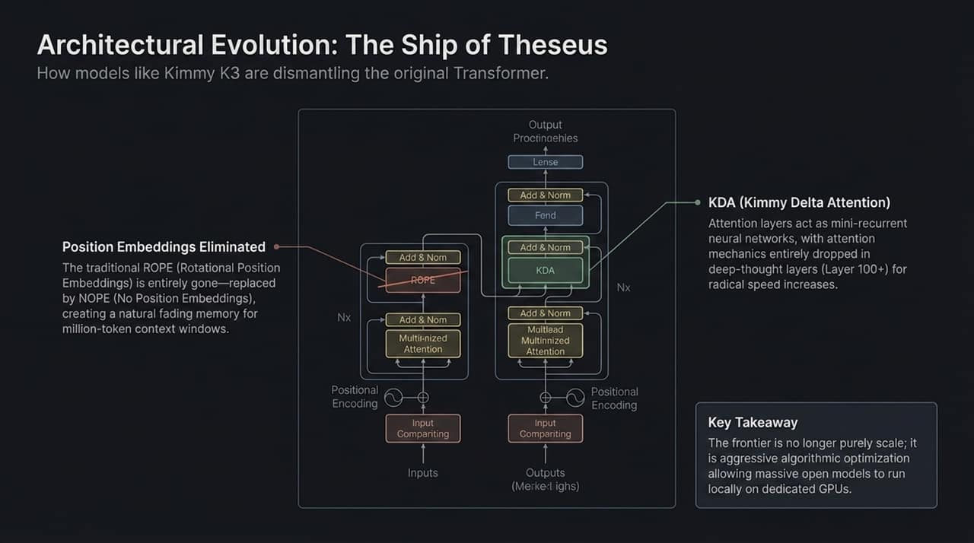
Notes:
The foundational 2017 Transformer architecture is undergoing a complete transformation."
"Modern open-weight models like Kimmy K3 are swapping out core components:"
"1. Elimination of Position Embeddings: Moving away from standard RoPE to NoPE (No Position Embeddings) unlocks near-infinite context windows without linear memory degradation.

Slide 7
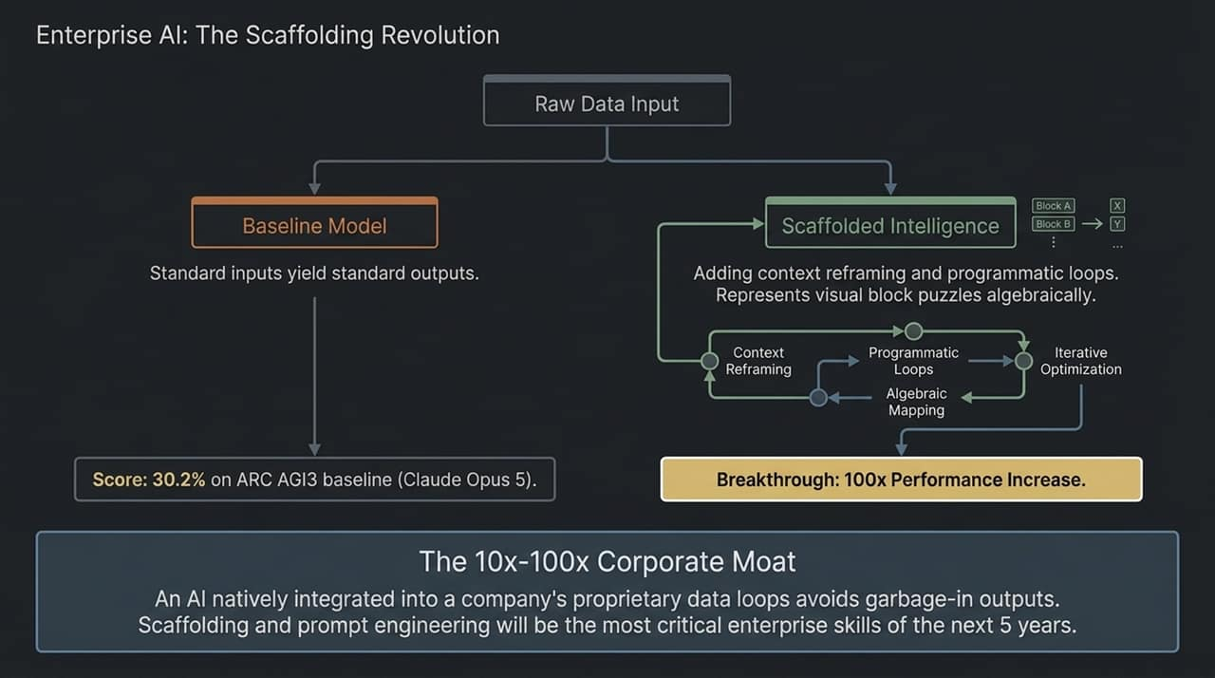
Notes:
Raw model intelligence is only half the battle; the real enterprise moat comes from Scaffolding."
"Standard baseline models scoring around 30% on complex logic benchmarks (like ARC AGI3) can reach a 100x performance leap when wrapped in programmatic loops, context reframing, and algebraic mappings."
"For enterprises over the next 5 years, competitive advantage won't come from building proprietary LLMs from scratch, but from integrating open models into proprietary data loops and custom execution scaffolding.

Slide 8
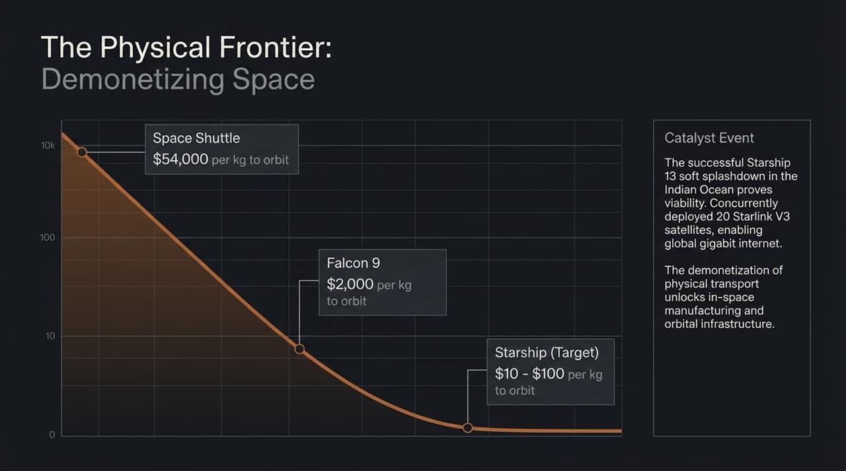
Notes:
Moving from bits to atoms: space launch costs are experiencing an unprecedented cost curve collapse."
"The Space Shuttle cost approximately $54,000 per kilogram to low Earth orbit. Falcon 9 brought that down to $2,000/kg."
"With Starship reaching operational milestones, cost targets drop to $10–$100 per kg."
"This radical cost reduction unlocks previously impossible industries: orbital manufacturing, space-based data centers, and global gigabit internet via Starlink V3.

Slide 9
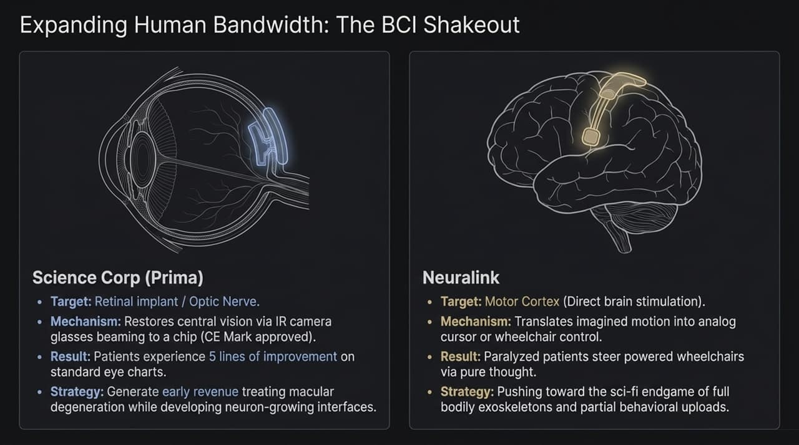
Notes:
Human-computer interaction is advancing beyond touchscreens and keyboards via two distinct Brain-Computer Interface strategies:"
"Science Corp (Prima): Focuses on near-term commercial viability with retinal implants that restore central vision for macular degeneration patients, delivering clear clinical and revenue milestones."
"Neuralink: Targets direct motor cortex implants to translate imagined thoughts into action, allowing paralyzed patients to operate digital devices and wheelchairs."
"Both approaches demonstrate that human input/output bandwidth is expanding rapidly to match super-intelligent systems.

Slide 10
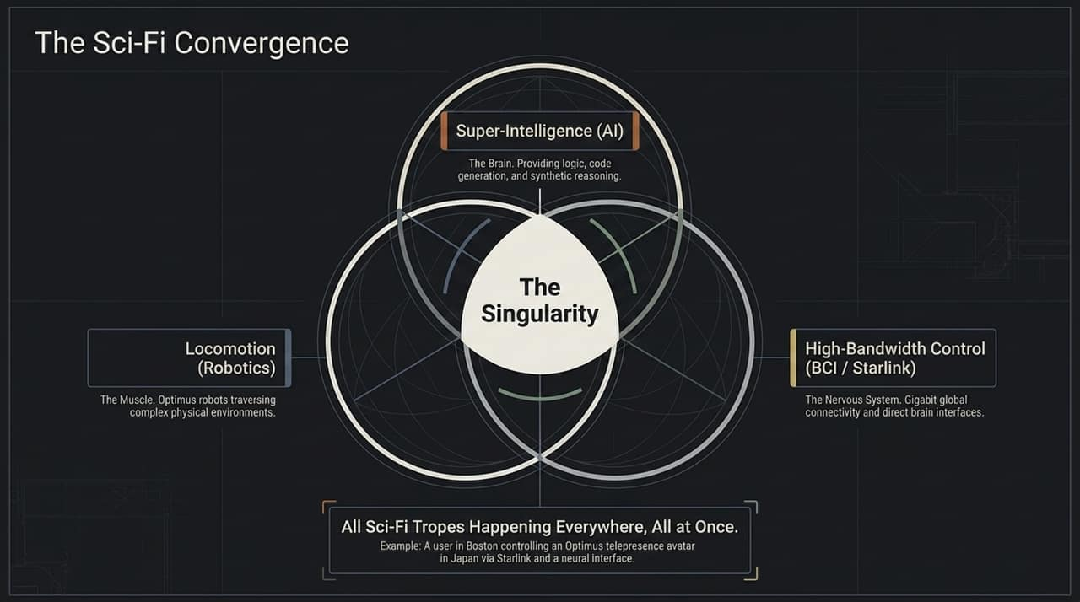
Notes:
We are witnessing the intersection of three major technological vectors:"
"1. Super-Intelligence (The Brain): Logic, code generation, and synthetic reasoning."
"2. Locomotion (The Muscle): Humanoid robotics like Optimus navigating physical spaces."
"3. High-Bandwidth Control (The Nervous System): BCIs and satellite constellations like Starlink."
"When these three domains converge simultaneously, sci-fi concepts transition into everyday reality.

Slide 11
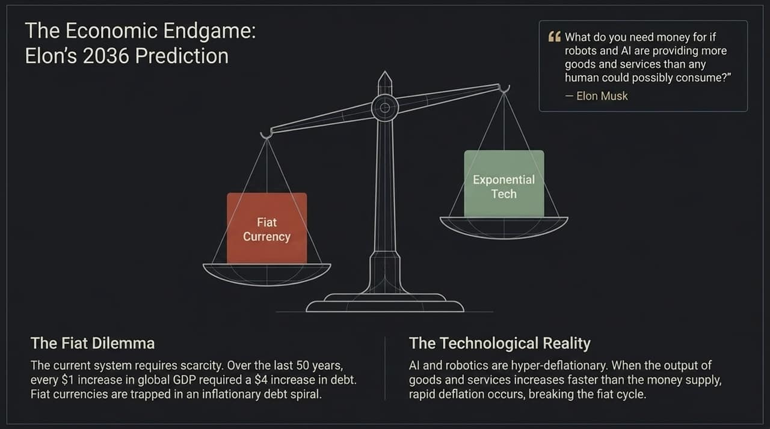
Notes:
What happens when AI and robotics generate more goods and services than humans can consume?"
"The Fiat Dilemma: The legacy financial system relies on scarcity and debt expansion ($4 of debt created per $1 of GDP)."
"The Technological Reality: AI and autonomous labor are hyper-deflationary."
"When production costs drop toward zero, fiat debt cycles break down, forcing a transition toward post-scarcity economic models by 2036.

Slide 12
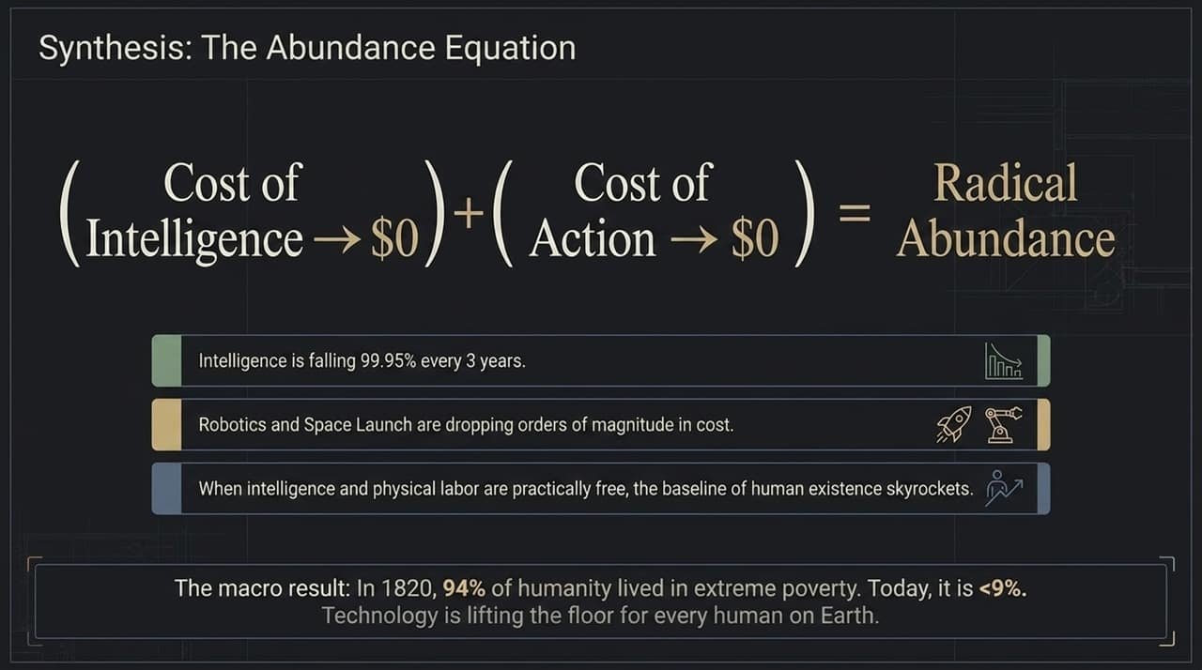
Notes:
This framework summarizes the transition to radical abundance:"
"
$$\text{Cost of Intelligence } (\to \$0) + \text{Cost of Action } (\to \$0) = \text{Radical Abundance}$$
"
"As software intelligence costs fall 99.9% and physical execution costs drop exponentially, the baseline standard of living rises globally."
"Historical precedent supports this shift: extreme poverty fell from 94% in 1820 to under 9% today, and technology continues to raise the baseline floor.

Slide 13
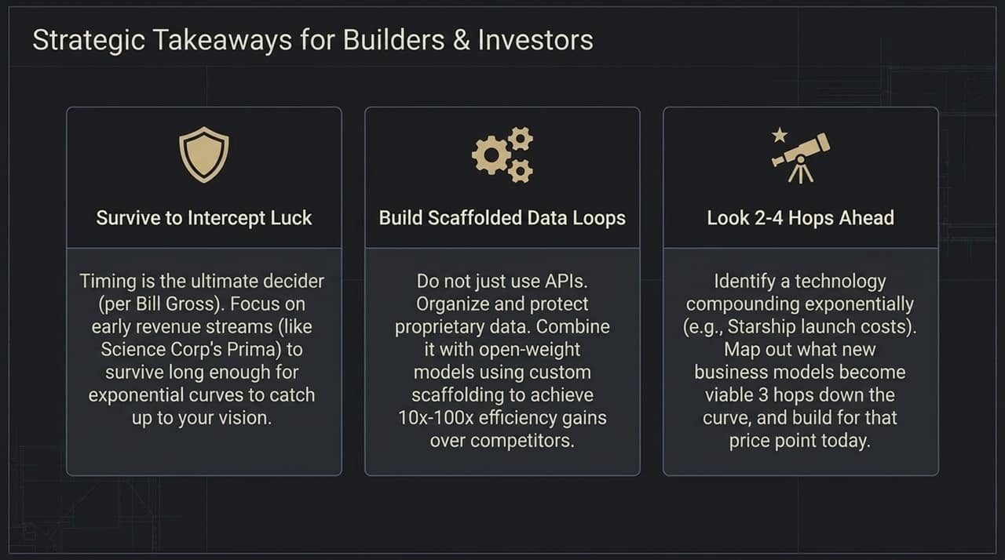
Notes:
Three key principles for navigating this landscape:"
"1. Survive to Intercept Luck: Timing is critical. Build near-term revenue streams to maintain cash flow while waiting for exponential curves to mature."
"2. Build Scaffolded Data Loops: Avoid relying solely on public APIs. Secure proprietary data and pair it with open-weight models for 10x–100x efficiency gains."
"3. Look 2–4 Hops Ahead: Identify exponential cost drops (e.g., Starship launch costs or cheap compute) and design business models built for future price points today.

Slide 14
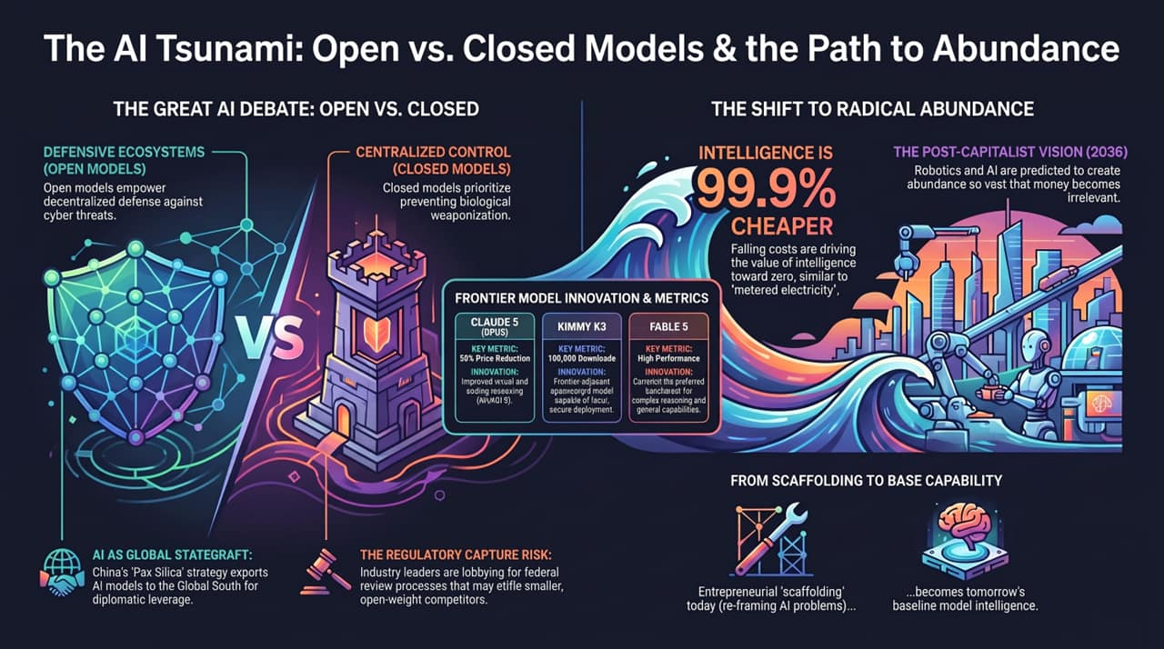
Notes:
To wrap up our briefing, this comprehensive landscape summary links our main themes:"
"The debate between open-weight security alliances and closed regulatory frameworks will shape global policy and market structure."
"As intelligence costs trend toward zero, value shifts from raw base models toward scaffolding, execution, and distribution ecosystems."
"Thank you for your time. I welcome any questions or discussion.

